Slide 1
Gender Inequality
Deidre Whittaker
Excelsior College
Robin Parks
6 Jul 2020

Slide 2
Gender Inequality
Refers to the unfair or unequal treatment of a person which is based on their gender.
It is a worldwide problem and challenge affecting both developed and developing nations.
Women have become victims in the gender inequality more than men.

Slide 3
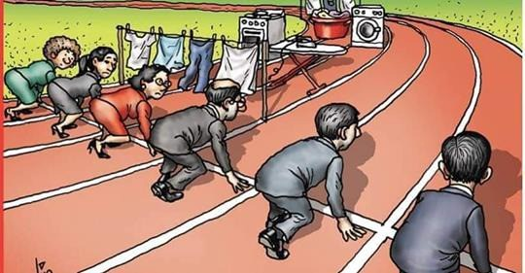

Slide 4
Effects of Gender Inequality
Holds back the growth of individuals, societies and countries development.
Unequal societies are less cohesive.

Slide 5
Why is the gender inequality an important issue

Slide 6
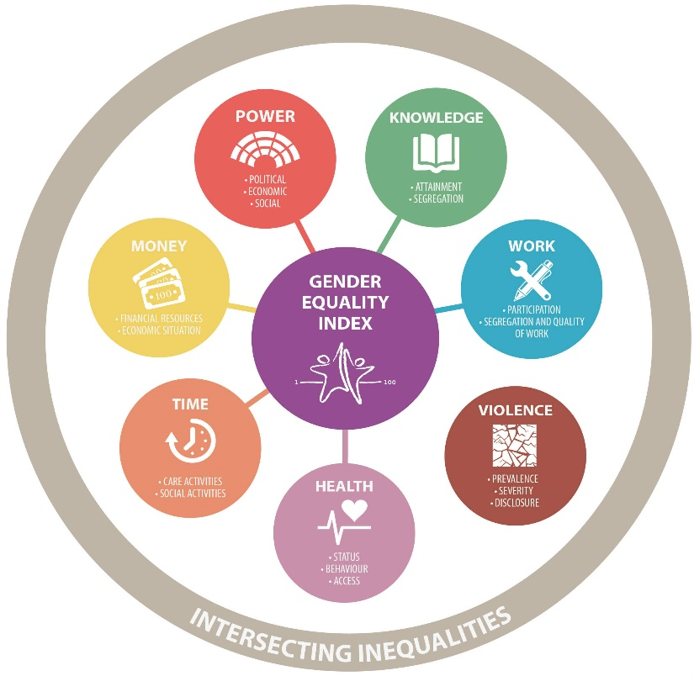
Importance of Combating Gender Inequality
                It stimulate economic growth, which is essential in low-income countries.
                Makes our communities safer and healthier
                They have higher rates of anti-social behaviour and violence.
                Despite the achievement, a lot needs to be done in order to achieve the equality among the two genders.
                Changing societal perception is key in dismantling this menace of gender inequality.
                Gender inequality data across the globe has proven the importance of having this discussion.
                Women are still suffering even in the 21st century due to this inequalities based on their gender.
                A lot of efforts have been made to ensure gender equity is achieved.
This Photo by Unknown Author is licensed under CC BY-SA

Slide 7
Examples of Gender Inequality

Slide 8
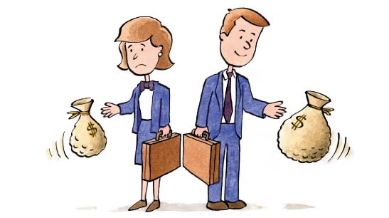
Examples Of Gender Inequality
Discrimination at workplace
Biasness in work promotions
Inequality in education opportunities
Inequality in earnings
Property ownership inequalities
Inequality in health access among the women
Political leadership inequalities
This Photo by Unknown Author is licensed under CC BY-NC-ND

Slide 9

Forms Of Gender Inequality Cont..
Gender based violence inequalities
Discrimination and biasness when raising a family
Family disputes inequalities
This Photo by Unknown Author is licensed under CC BY-NC-ND

Slide 10
Why is it my problem

Slide 11
Nature of Gender Inequality

Slide 12
Nature Of Inequality Based On Culture
Women in some cultures are deemed inferior just by the nature of their gender
This is more evident among the African and the Asian communities
They are supposed to respect and take orders from the male gender
They cannot have a voice of their own

Slide 13
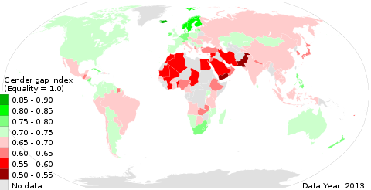
Workplace and Career
There are career that are deemed to be male oriented and women should not take such.
This has discouraged many women who may even do better than their male counterparts in the same field
This has led to a disparity even in the earnings for the female gender
Promotions among the women are very rare at the workplace.
This Photo by Unknown Author is licensed under CC BY-SA

Slide 14


Slide 15
Workplace and Career
The male gender still belief that women should not take leadership roles in the society just because they are female.
Women have been denied political leadership especially the elective positions because of such bias and inequality.

Slide 16
Solutions to Gender Inequality

Slide 17

Solutions to Gender Inequality
Change society belief that male gender is superior to female gender.
Start schools that cater for the disparity in education and academics for the girl child.
Empower women in leadership by achieving the 3rd gender rule by UN.
This Photo by Unknown Author is licensed under CC BY

Slide 18
Solutions to Gender Inequality
Share household chores
Have laws that govern against domestic violence
Develop protocols for promotion at workplaces
Pay salaries based on work done and not based on salaries
Zero tolerance on sexual harassments and racism

Slide 19
Citations

Slide 20
References
Heise, L., Greene, M. E., Opper, N., Stavropoulou, M., Harper, C., Nascimento, M., ... & Henry, S. (2019). Gender inequality and restrictive gender norms: framing the challenges to health. The Lancet, 393(10189), 2440-2454.
Blau, F. D. (2016). Gender, inequality, and wages. OUP Catalogue.
Huang, J., Gates, A. J., Sinatra, R., & Barabási, A. L. (2020). Historical comparison of gender inequality in scientific careers across countries and disciplines. Proceedings of the National Academy of Sciences, 117(9), 4609-4616.
Kleven, H., & Landais, C. (2017). Gender inequality and economic development: fertility, education and norms. Economica, 84(334), 180-209.
Batra, R., & Reio Jr, T. G. (2016). Gender inequality issues in India. Advances in Developing Human Resources, 18(1), 88-101.
Scott, S. (2018). Gender Inequality in America: Is it Here to Stay?.

Slide 21
References cont..
Fisher, B., & Naidoo, R. (2016). The geography of gender inequality. PLoS One, 11(3), e0145778.
Bukhari, M. A. H. S., Gaho, M. G. M., & Soomro, M. K. H. (2019). Gender Inequality: Problems & Its Solutions In Pakistan. The Government-Annual Research Journal of Political Science., 7(7).
Ryabokon, I. (2016). Gender inequality and the quality of work life in Ukraine. Zeszyty Naukowe Polskiego Towarzystwa Ekonomicznego w Zielonej Górze, 3(4), 204-217.
Newton, D. E. (2019). Gender Inequality: A Reference Handbook. ABC-CLIO.
Kim, J., Lee, J. W., & Shin, K. (2016). A model of gender inequality and economic growth. Asian Development Bank Economics Working Paper Series, (475).

